Slide 1
SHAPING THE FUTURE OF A DIGITALLY CONNECTED COMMUNITIES THROUGH SMART REGULATIONS
Mothibi Glenview Ramusi, ITCP(SA)
Chairperson
ICASA
21 November 2024

Slide 2
FACT SHEET
Eradicate poverty, reduce inequality and drive inclusive economic growth by 2023 | NDP 2030
Common theme throughout the government economic strategy since 1994 has been the emphasis on infrastructure
Digital economy is a major contributor to the overall national economy | adoption of 5G is estimated to contribute 0.37% of GDP in 2023 [GSMA 2023 Mobile Economy Africa]
Digital economy has created more entrepreneurial | on-line retail startups | in 2021, 56.7% in wholesale and retail

Slide 3
CONNECTING THE UNCONNECTED
Infrastructure Development | equality, zero trust architecture
Affordable Access | inclusive
Policy and Regulation | agility
Digital Literacy | partnership with academia
Collaboration and Partnership | The world, Social partners
Energy Access | alternatives

Slide 4
CONNECTING THE UNCONNECTED
Allocating and managing spectrum efficiently, especially for rural broadband initiatives.
Supporting community networks through regulatory frameworks.
Facilitating Universal Service and Access Funds (USAF) to subsidize connectivity projects.
Promoting fair competition to ensure affordable access.
Ensuring participation of youth, women and people with disability

Slide 5
FRAMEWORK FOR SMART REGULATIONS
Proactive and forward-thinking approach
Community and Stakeholder Engagement
Flexibility and Adaptability
Encourage Competition and Innovation
Balancing Control and Freedom
Sustainability and Inclusivity

Slide 6
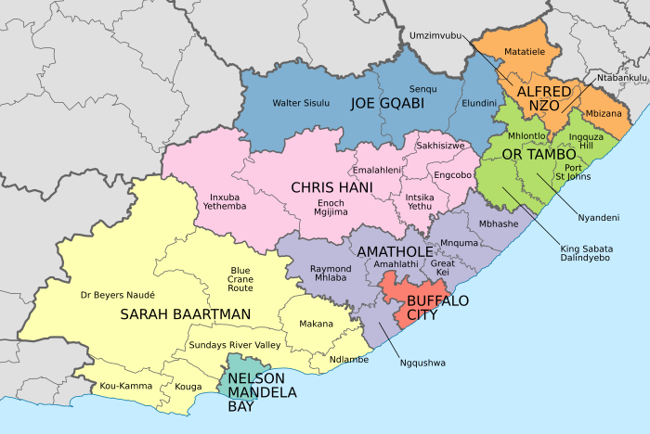
Profile - Eastern Cape Province
Eastern Cape
2nd Largest province (168,966 sq Km)
2 x Metropolitan Municipalities
6 x Districts Municipalities
27 Local Municipalities
Largest City – Gqeberha (NMB)
Capital – Bhisho (BCM)
Eastern Cape Province borders the neighbouring country of Lesotho.
Provincial borders are shared with the Western Cape, Northern Cape, Free State and Kwa-Zulu Natal provinces

Slide 7
Coverage per province
Year 2023
 | Urban area |  |  |  | Rural area
Network coverage per Province | 2G | 3G | 4G | 5G | 2G | 3G | 4G | 5G
Eastern Cape | 100% | 100% | 100% | 33% | 100% | 98% | 94% | 1%
Free State | 100% | 100% | 100% | 17% | 100% | 98% | 96% | 4%
Gauteng | 100% | 100% | 100% | 69% | 100% | 100% | 100% | 16%
KwaZulu-Natal | 100% | 100% | 100% | 66% | 100% | 97% | 97% | 5%
Limpopo | 100% | 100% | 100% | 42% | 100% | 99% | 99% | 12%
Mpumalanga | 100% | 100% | 100% | 36% | 100% | 99% | 99% | 21%
North West | 100% | 100% | 100% | 38% | 100% | 100% | 100% | 12%
Northern Cape | 100% | 100% | 97% | 31% | 94% | 91% | 85% | 0%
Western Cape | 100% | 100% | 100% | 62% | 96% | 92% | 88% | 11%

Slide 8
Profile - Eastern Cape Province
Population density in the Eastern Cape
<1 /km²
>3000 /km²
1–3 /km²
3–10 /km²
10–30 /km²
30–100 /km²
100–300 /km²
300–1000 /km²
1000–3000 /km²
Eastern Cape Population distribution
Population = 7.2 m (2022)
OR Tambo is the most populous district with 21%, followed by Nelson Mandela Bay Metro with 18%
91% of Eastern Cape population has access to electricity

Slide 9
Eastern Cape Community Radio
Notes:
Community TV Broadcaster, called Trinity Broadcast Network is no longer active as their license expired.

Slide 10
Eastern Cape – Maritime Licenses 2020-2024

Slide 11
Coverage per province
Year 2023
 | Urban area |  |  |  | Rural area
Network coverage per Province | 2G | 3G | 4G | 5G | 2G | 3G | 4G | 5G
Eastern Cape | 100% | 100% | 100% | 33% | 100% | 98% | 94% | 1%
Free State | 100% | 100% | 100% | 17% | 100% | 98% | 96% | 4%
Gauteng | 100% | 100% | 100% | 69% | 100% | 100% | 100% | 16%
KwaZulu-Natal | 100% | 100% | 100% | 66% | 100% | 97% | 97% | 5%
Limpopo | 100% | 100% | 100% | 42% | 100% | 99% | 99% | 12%
Mpumalanga | 100% | 100% | 100% | 36% | 100% | 99% | 99% | 21%
North West | 100% | 100% | 100% | 38% | 100% | 100% | 100% | 12%
Northern Cape | 100% | 100% | 97% | 31% | 94% | 91% | 85% | 0%
Western Cape | 100% | 100% | 100% | 62% | 96% | 92% | 88% | 11%

Slide 12
Eastern Cape USAO’s
Mainstream schools
Eastern Cape USAO : Mainstream Schools
1. Vodacom | 368
2. MTN | 214
3. Cell C | 214
4. Liquid Telecom | 0

Slide 13
Eastern Cape USAO’s
Schools for Learners with Special Educational Needs (SLSEN)
Eastern Cape USAO : SLSEN
1. Vodacom | 16
2. MTN | 18
3. Cell C | Roll –out still to be done
4. Liquid Telecom | 7

Slide 14
Eastern Cape USAO’s
IMT Spectrum Auction USAO’s:
 | Health Facilities | Schools | Libraries | Traditional Authorities
Liquid Telecoms | 0 | 0 | 0 | 0
MTN | 242 | 950 | 33 | 67
RAIN | 109 | 394 | 20 | 27
Telkom | 110 | 438 | 19 | 19
Vodacom | 311 | 1059 | 40 | 77

Slide 15
Eastern Cape USAO’s
Other USAO’s : Telkom
To reduce public payphones from the general public and limit it to correctional services;
Basic Telephone Services, to be replaced by Thusong Service Centres; and
Directory Services, to be replaced by Thusong Service Centres.

Slide 16
Eastern Cape USAO’s
Other USAO’s : Sentech and RAIN
Sentech – Must connect :
7 Community Education and Training (CET) College Sites
2 Community Learning Centres (CLC) are already connected,
The licensee is currently connecting 3 Community Learning Centres .
Rain – Must Connect :
7 CET College Sites,
2 Community Learning Centres are already connected;
The licensee is currently connecting 4 CLCs.

Slide 17
Eastern Cape USAO’s
Other USAO’s : Broadband Infraco
Broadband Infraco (countrywide including EC):
Has an obligation to deploy 37 Point of Presence (PoPs),
Has deployed 29 PoPs
Still to deploy 8

Slide 18
Eastern Cape : Postal
Postal Outlets:
South African Post Office (SAPO):
Has = 126
Closed =19
Retained = 107

Slide 19
Eastern Cape : Broadcasters
Broadcasters:
Community Broadcasters :
1 Community TV - Faith TV
25 Community Sound
Private Broadcasters :
2 Private Radio (Algoa FM & Rhythm FM)

Slide 20
Eastern Cape : Maritime
Maritime
Maritime Coastal Station ( non- commercial) | 3
Maritime Fixed Stations ( Beacon, Radar) | 6
Maritime : Ship Station | 1 357
Total : | 1 366

Slide 21
Eastern Cape : IECS / IECS BEE Numbers
IECS/IECNS Licences with BEE in EC: = 289

Slide 22
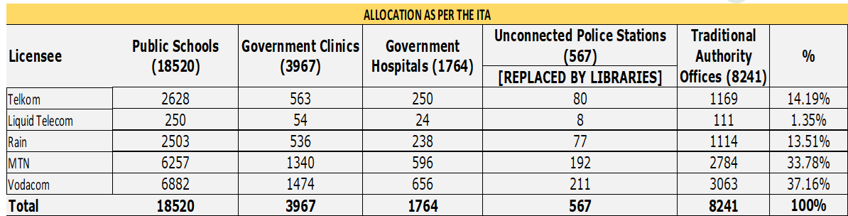
METHODOLOGY APPLIED IN THE ALLOCATION PROCESS
Proportionality:
  The PSIs were allocated based on proportionality to the amount of the IMT Spectrum assigned to each licensee.
  296 MHz of the IMT Spectrum was assigned post the auction process.
  Telkom was allocated 14.19% of the total PSIs considering that they were issued 42 MHz of the IMT Spectrum after the auction.

Slide 23
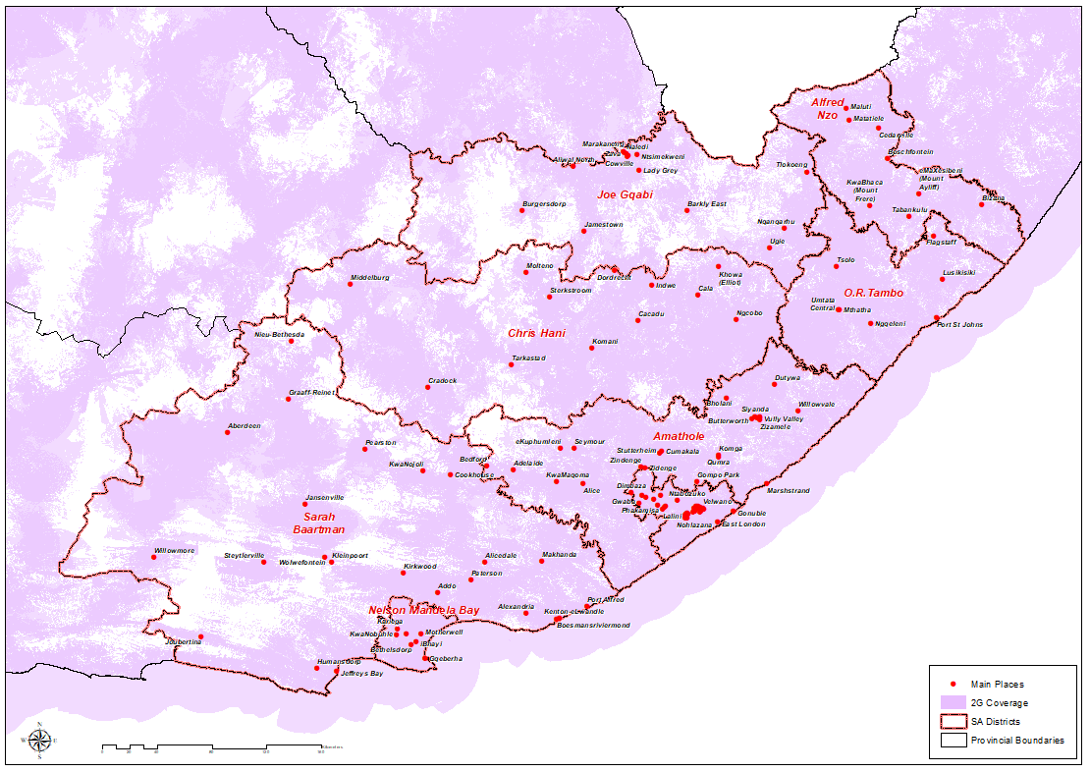
EASTERN CAPE 2G COVERAGE MAP

Slide 24
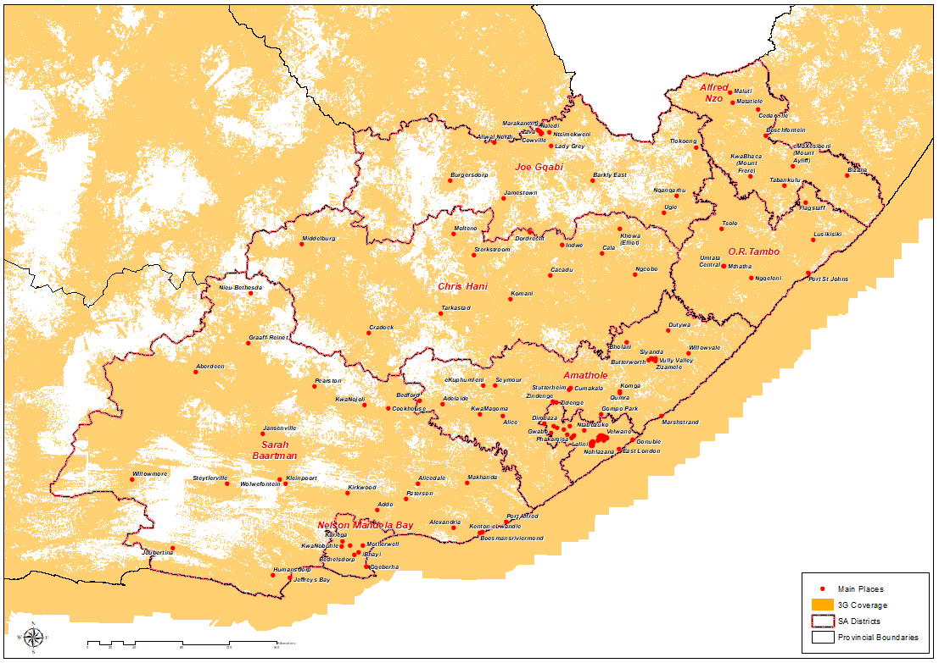
EASTERN CAPE 3G COVERAGE MAP

Slide 25
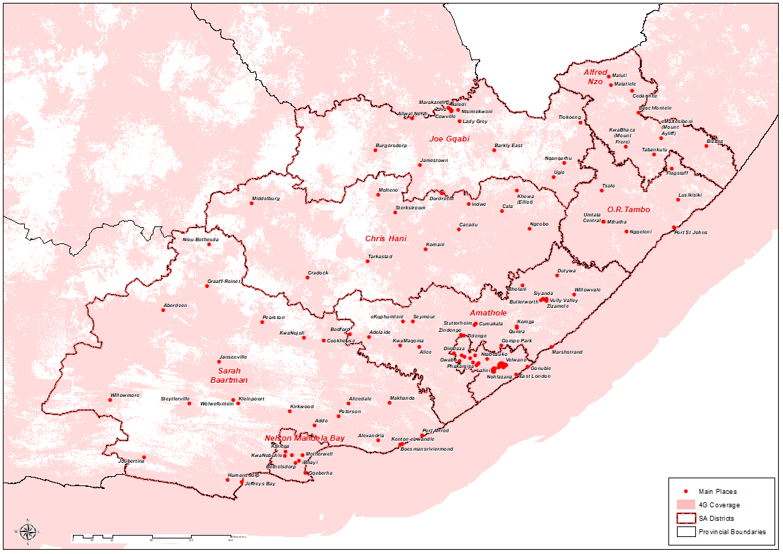
EASTERN CAPE 4G COVERAGE MAP

Slide 26
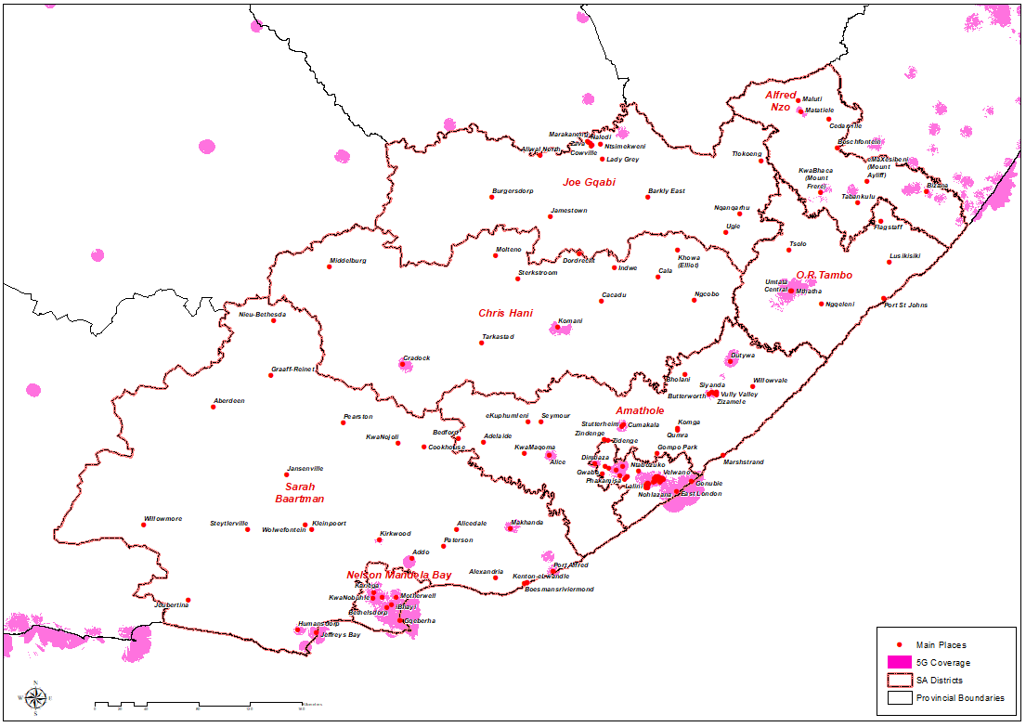
EASTERN CAPE 5G COVERAGE MAP

Slide 27
CHECK AND BALANCES
Established an ICT and media Forum : ICASA, Film and Publication Board, za Domain Authority, Information Regulator | tackle some ills in the social media
Inquiry on satellite licensing framework
Signal Distribution
Subscription TV
Ownership and Control
End User and subscriber service charter
Reopening of the licensing process for Community Sound Broadcast
Digital Migration | Load shedding

Slide 28
NEXT STEPS
Review : Policy and Regulatory and other related legislative frameworks
Data Mining | clearly articulating the current problem statement
Infrastructure modelling | closing of identified network gaps
Advancing the program of reducing cost to communicate
Availing spectrum for new emerging technologies and support of new industries
Attend to RICA matters, quality of service and international termination calls
Adherence to standards and Compliance
Clarion call to participate on ICASA public processes

Slide 29
DIGITAL ECONOMY MENU : KE NAKO!
Passive infrastructure | Towers, Fiber build, ….
Telecoms network operators | Mobile, Satellite,….
Digital infrastructure providers | Data Centre, System integrators, Cloud providers,…
Digital Companies | Fintech, Software
Government | R&D, e-Government
Communications Providers | Voice, data, media
Support, Supply and Maintenance | customer interaction, supplier management

Slide 30
THANK YOU

